Slide 1



Have you searched the Library catalogue? Migrating catalogue records from pre-internet software to a modern library management system supporting MARC21
Martin Lucas-Smith
Peter Lund
Notes:
The Polar Library is situated in the Scott Polar Research Institute which is part of the University of Cambridge. Our library supports the Institute’s 30 postgraduates as well as academic staff and post-docs. Other users include: Researchers and students from other departments notably Geography and social science subjects and visiting scholars who come from all round the world to study with us. Although not large in number some visiting scholars come on sabbatical and stay with us for up to six months. We also welcome members of the public interested in researching the polar regions or glaciology.
As the Institute’s Librarian my answer to most subject enquiries tend to start with – “Have you searched the library catalogue?” Just like the phrase “have you tried turning it off and on again” on the IT Crowd it’s almost a mantra. But our library catalogue was not easy to use and until recently it was only available in the Library itself.
So asking users to search for themselves was quite a hard sell.

Slide 2

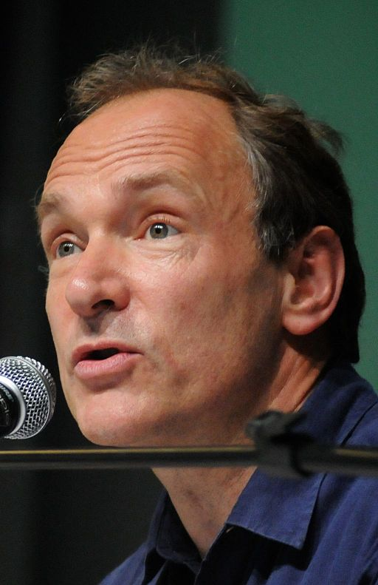

Introduction
Photo credit Silvio Tanaka CC BY 2.0
Photo credit: Juan Cristobal Cobo CC BY 2.0
Notes:
Until we migrated our electronic catalogue to Alma in October 2019 our catalogue was held in Muscat - a museum catalogue system dating from 1985. So well before Tim Berners-Lee came up with the World Wide Web!. With readers growing up with the web based services our Muscat catalogue was very out of date and no longer supported by the company who had provided it.
Time to change -
.

Slide 3
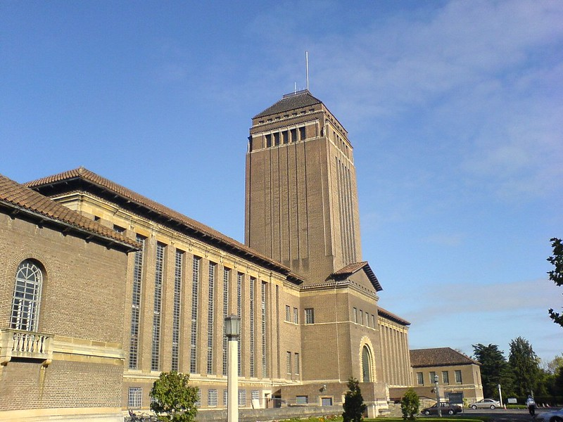
Aim: to create a shared catalogue in Alma searchable through Primo (iDiscover)
Photo credit: Linda CC BY 2.0
Notes:
Our aim was to migrate the catalogue into the catalogue used by most of the University of Cambridge. At the start of the project this was Voyager but in 2017 the University moved to Alma.
There are 116 libraries within the University of Cambridge. These include the main University Library, twenty-one affiliated libraries, departmental and faculty Libraries, College Libraries, and various other specialist libraries associated with the University. Nearly all using the ExLibris products: Alma for cataloguing and Primo which acts as the discovery tool.
We sought to migrate our catalogue so that we could be part of the shared catalogue across Cambridge. This greater visibility would we hoped increase the use of the Library, improve the quality of our catalogue records by conforming to MARC21, RDA and AACR2 standards and enable library staff to benefit from copy cataloguing.
We didn’t want to be the last library in Cambridge to migrate!

Slide 4
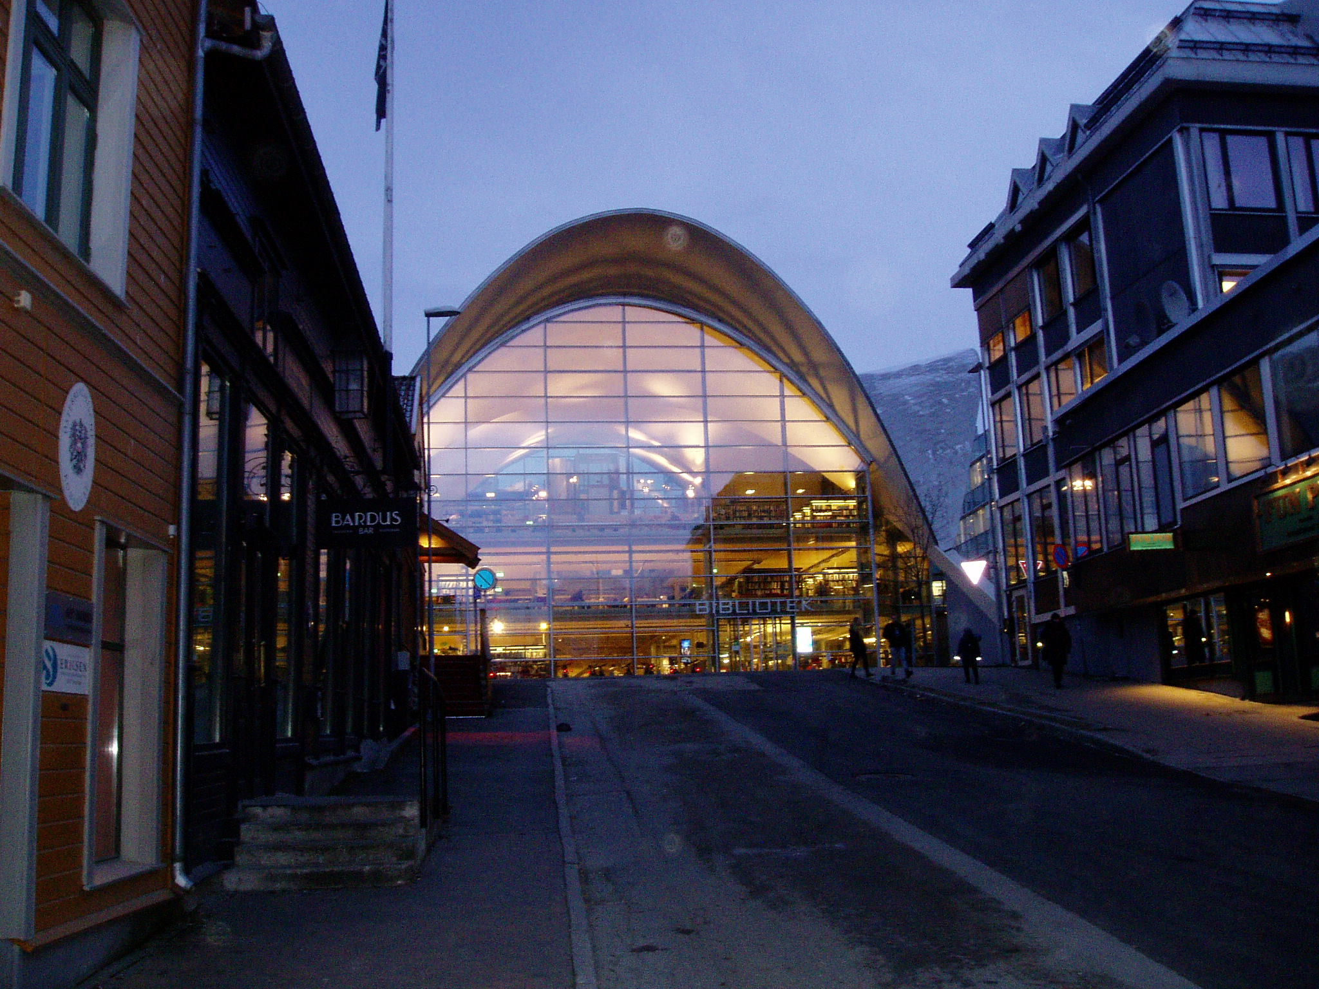
Widely accessible in the Arctic…
Public Library, Tromsø
Notes:
We also wanted our readers to be able to see the catalogue from anywhere in the world with an internet connection…in the Arctic…

Slide 5
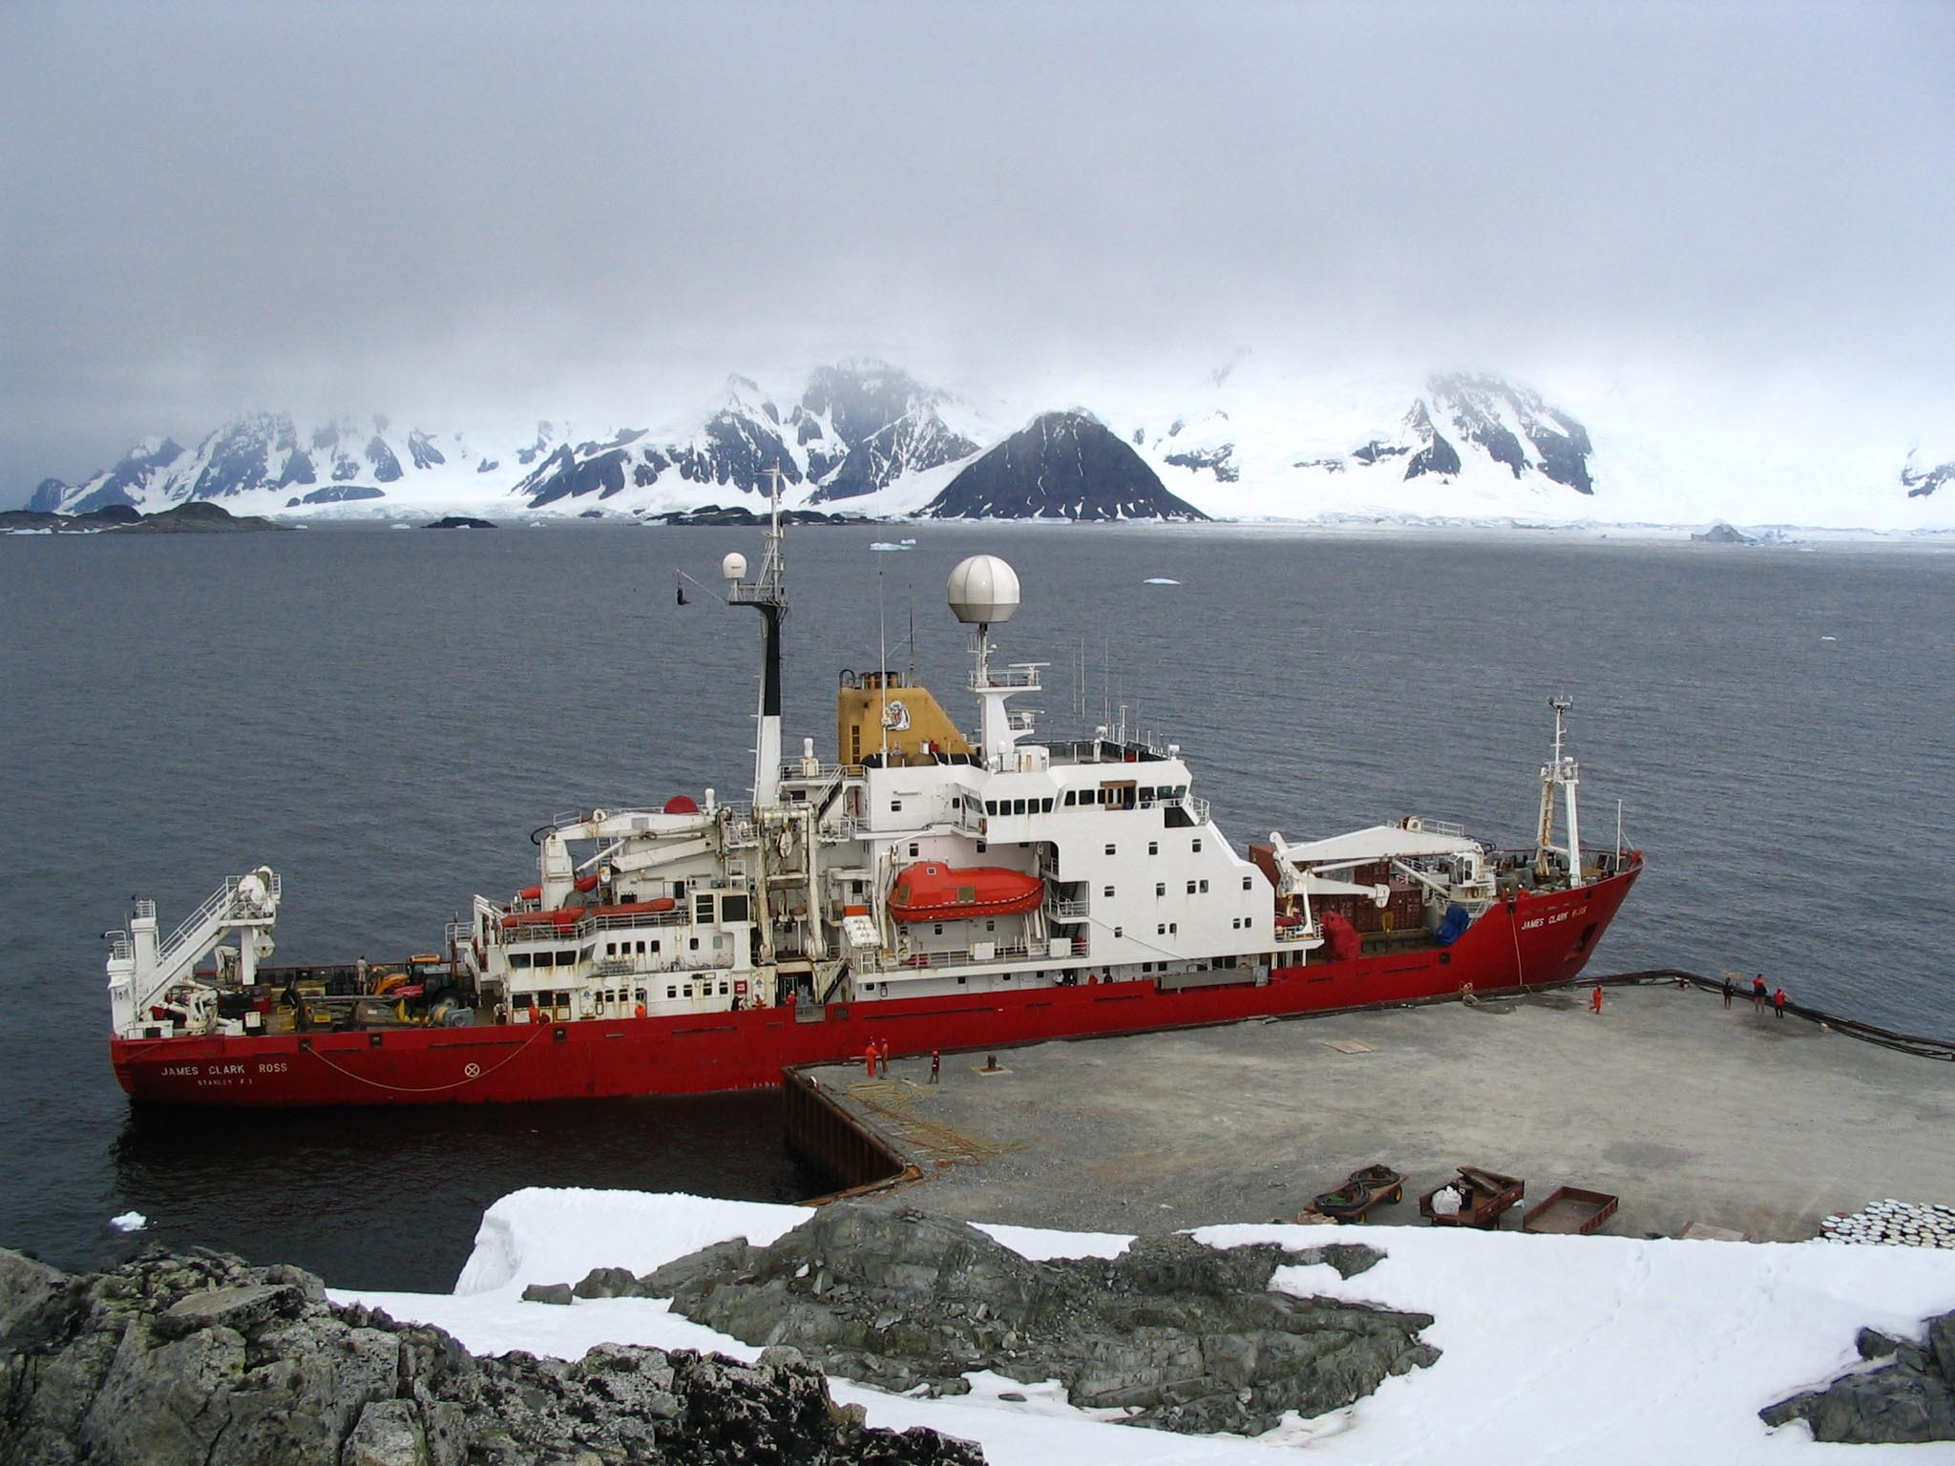
…and Antarctic
The James Clark Ross, Rothera Research Station, British Antarctic Survey
Notes:
and even in the Antarctic in advance of a visit.
Our catalogue contains 50,000 monographs in 90 languages including Russian, Inuktitut and Sami adding to the complexity of migration. Our collections about the Russian North, many of which are in Russian language, are particularly strong. We also have records of maps, DVDs, pamphlets.
The catalogue also has analytical records for over 100,000 journal articles and book chapters – a legacy from when we produced an abstracting journal called Polar and Glaciological Abstracts.

Slide 6
Bibliography – Polar UDC and Muscat
Gilbert, M; Lane, H. (2008) Forty-five numbers for snow: a brief introduction to the UDC for Polar libraries. Extensions and Corrections to the UDC, 30 (2008), pp. 23-26. http://hdl.handle.net/10150/110845
Porter, M. and Galpin, V. (1988), "Relevance feedback in a public access catalogue for a research library: Muscat at the Scott Polar Research Institute", Program: electronic library and information systems, Vol. 22 No. 1, pp. 1-20. https://doi.org/10.1108/eb046983
Notes:
The Polar Library uses Polar UDC to index catalogue records. This classification scheme is derived from the Universal Decimal Classification with additional sections for the polar regions. As you can see from this sample our records have very deep subject indexing and we were very keen to maintain this level of meta data in the migration process.

Slide 7
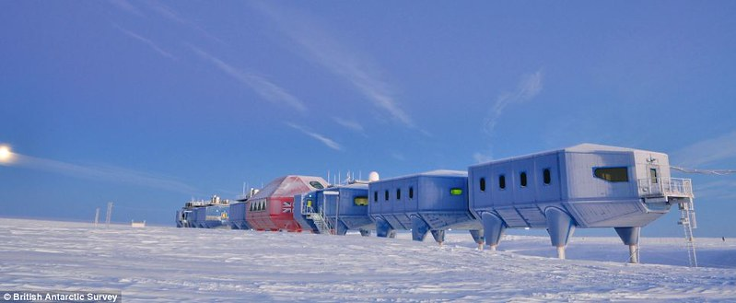
Impact
Increase in visits to library by first time users and Geography undergraduates
Increase in inter-library loan requests
Catalogue is accessible from (almost) anywhere
Photo credit: Hugh Broughton Architects Halley VI centre CC BY 2.0
Notes:
Our catalogue is available on the web and users can and do search for themselves. This has quickly led to an increase in visits to the library by first time users. Indeed this impact was nearly instantaneous - an English language student showed up in our library asking for a specific title the first day our catalogue became available in iDiscover!.
Since then we’ve also seen an increase in use of the library by Geography students and an increase in inter-library loan requests too.

Slide 8
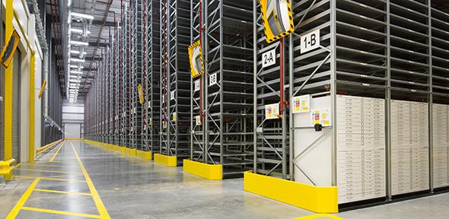
Further developments
Enabled creation of reading lists in Leganto.
Using Alma facilitated transfer of low use serials to off site store
Notes:
The Polar Library is running out of space! We are collaborating with the University Library in transferring low use serials to the University’s off site store in Ely, Cambridgeshire. The creation of holdings and item records in Alma has ensured the location of these holdings can be changed very quickly and easily.
Whilst this project has been put on hold during lockdown we have been busy this summer creating reading lists for our Geography undergraduates and Masters students using Leganto. This provides clickable links to records in iDiscover and links to the full text of articles and e-books. In the Covid-19 era this has been invaluable.

Slide 9

Emma Coonan
George Cronin
Martin French
Rick Frolich
Pete Girling
Janey Huber-Reacher
Robin James
Ann Keith
Martin Lucas-Smith
Frankie Marsh
Sarah Middle
Niamh O’Mahony
Hilary Shibata
Paul Taylor-Crush
Isabella Warren
Jeremy Wong
Notes:
During the course of this project many people both in SPRI and the University Library helped with the mapping of fields, with data cleansing and sandbox testing.

Slide 10

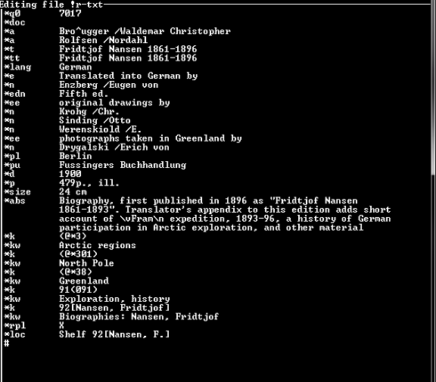
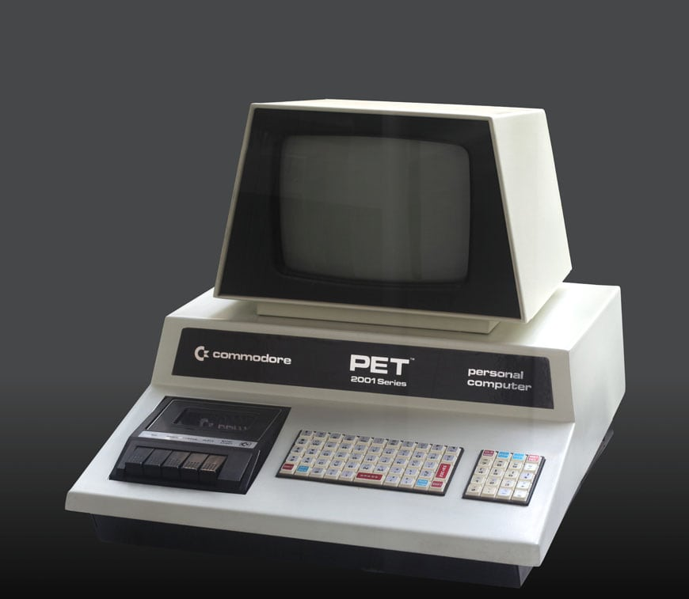

Muscat: 1980s technology
204,000 records
c. 100 person years work
Not MARC
Pre-unicode
Little validation
No authority control
Muscat - 1980s database

Slide 11
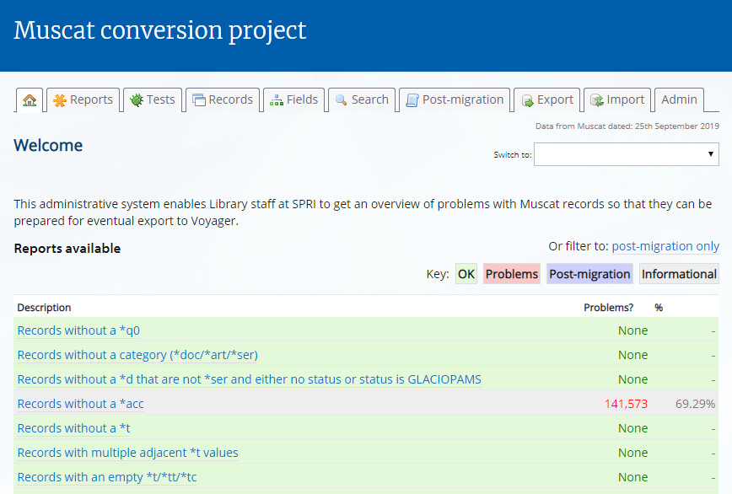
The conversion process
6-12 hours overnight
Data import
Mixture of writing code, and fixing records: highly iterative
About 200 days of coding work over 7 years.
Notes:
Very conscious of the weight of history – only get one chance to do it properly.

Slide 12
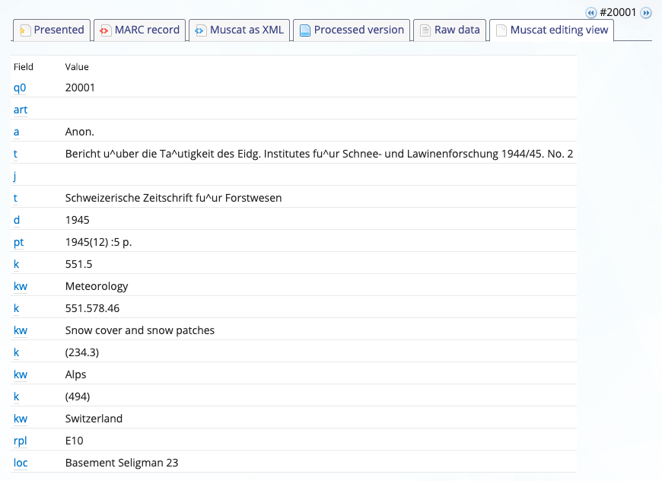
Conversion process
STAGE 1. Convert 200MB text dump to a database
We then had a basic key-value pair database, of 9m individual data lines, about 40 per record.

Slide 13
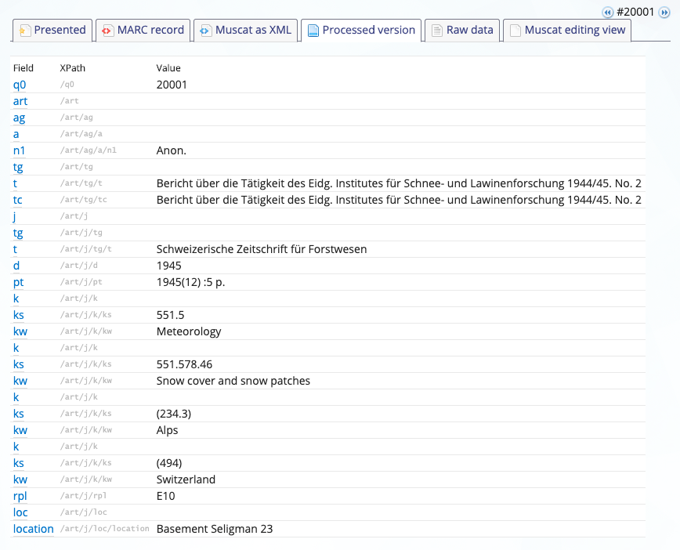
Conversion
2. Interpret the record structure.
Used Xpath to ‘drop’ a flat-structured record into a schema.
Also turned proprietary character codes into Unicode, e.g. a^u into ä

Slide 14
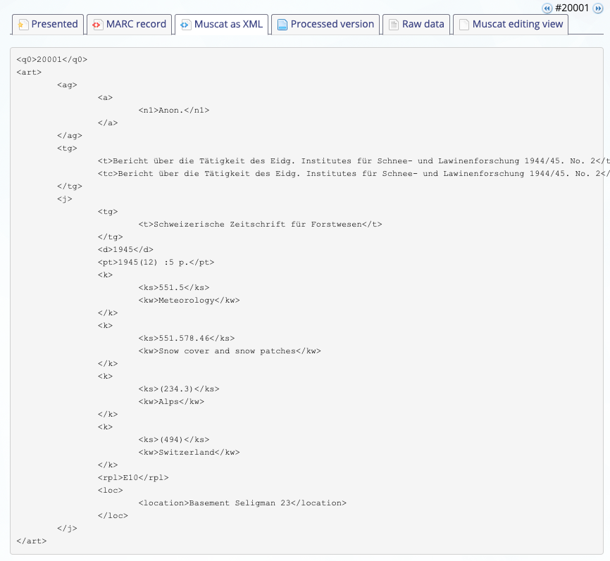
Conversion
3. Converted the hierarchy into XML.
Now have a structure easier to manipulate.
Can now determine parent-child relationships.
Also things like which author is 4th.

Slide 15
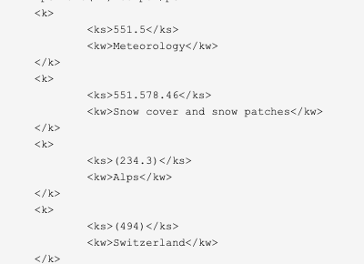
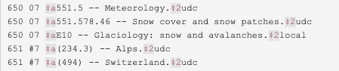
Conversion
4. Start with basic mappings of Muscat to MARC for each field
E.g. loop though each *k (UDC classification number) pair, and map to a 650 or 651.
Soon we had some very basic MARC records.

Slide 16
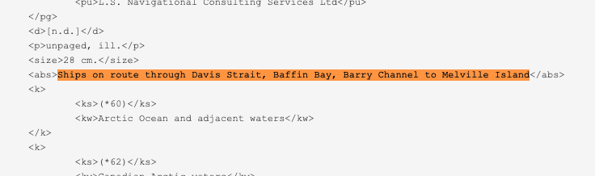
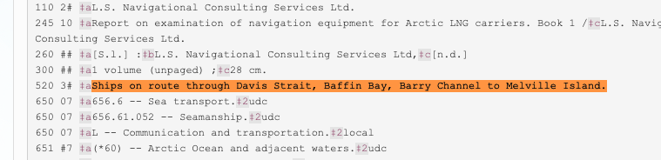
Conversion
5. Extend this principle, by create macros for each MARC field conversion.
Basically each {…} block is a placeholder to be filled in. E.g. this macro says:
Take //abs contents, and put into 520 3# $a{…} and add a dot at end.

Slide 17
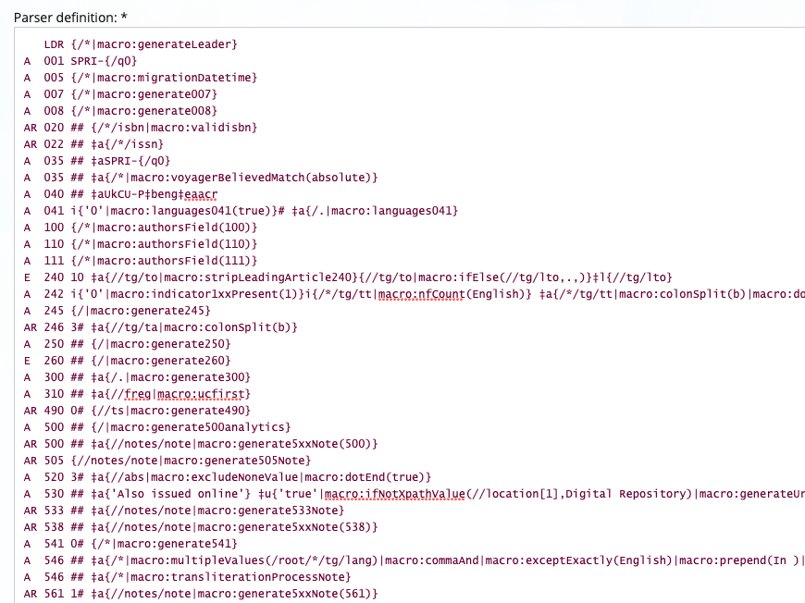
Conversion
6. Full macro definition. Mapping each MARC field from Muscat fields.
Each MARC line ‘looks up’ data from the Muscat XML and processes it through a macro.
https://github.com/camunigeog/muscat-conversion/blob/master/tables/marcparser.txt

Slide 18
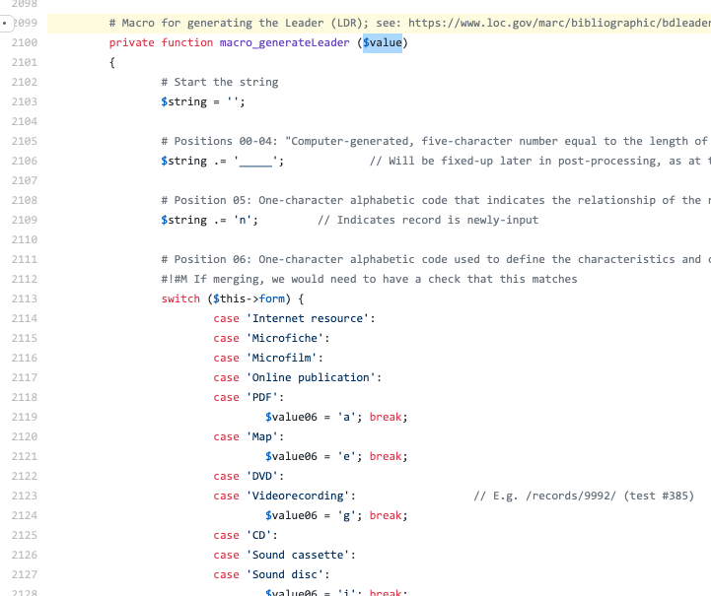
Conversion
7. Each macro has quite complex logic.
Receives the value from the Macro definition, then builds the result.
E.g. this shows the LDR. *form=Map becomes LDR position 6 = e
https://github.com/camunigeog/muscat-conversion/blob/master/marcConversion.php#L2099

Slide 19
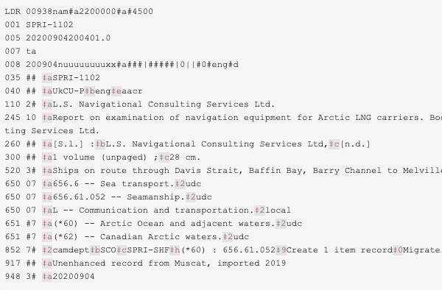
Conversion
8. Eventually end up with a full MARC record.
Generated live. (Change logic and refresh shows change.)
Iteration and testing with the OPAC.
Thanks to Rick Frohlich whose work was critical
www.spri.cam.ac.uk/library/catalogue/records/1102/

Slide 20
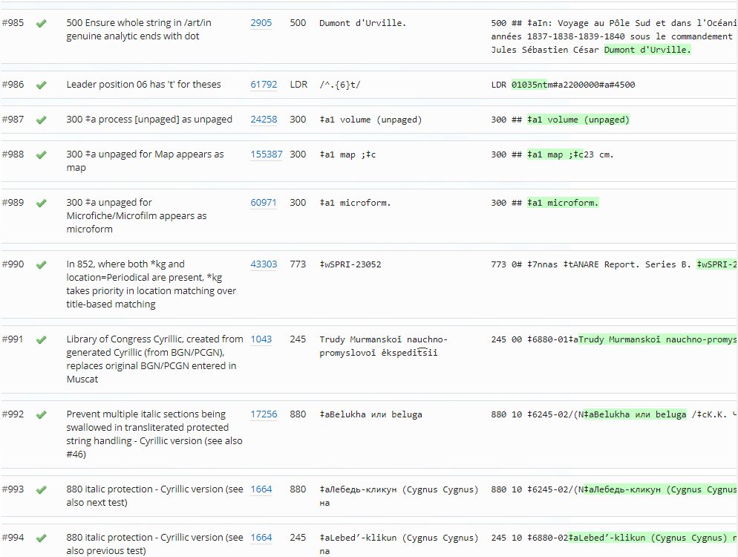
Reports and tests
Extensive reports
Data cleanup work
1,071 tests
Test for every conversion feature

Slide 21
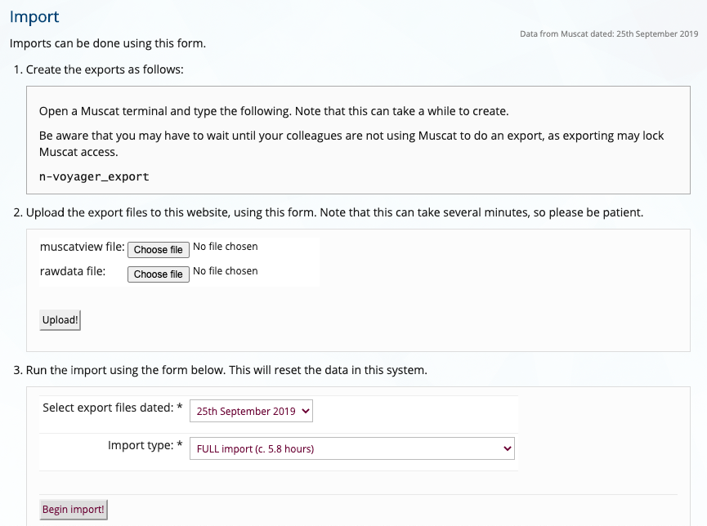
Conversion
9. Loop through all 204,307 records.
We ran this overnight, took between 6-12 hours!

Slide 22
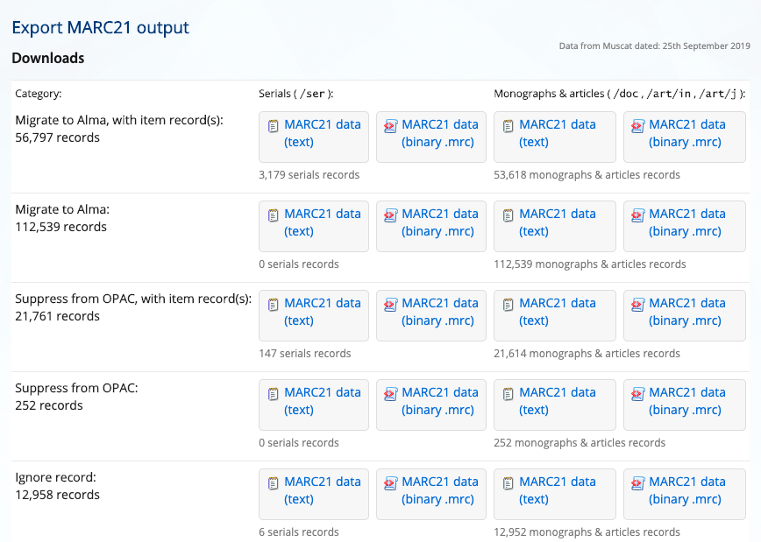
Conversion
10. Run through MarcEdit, and Bibcheck
Final stage of import. Converts MARC text to .mrc format, using MarcEdit (not UI). Used Bibcheck, to check for problems.

Slide 23
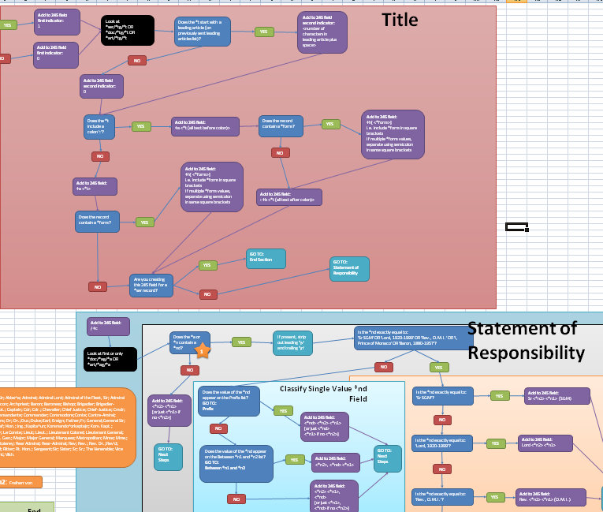
Authors: 1xx/7xx/245
Flow chart for each field
Emulated SoR
2nd+ 1xx mutates to 7xx
Contributor terms
(880 handling also!)

Slide 24
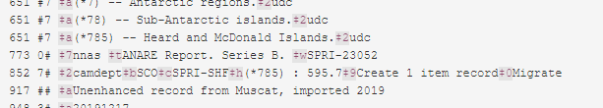
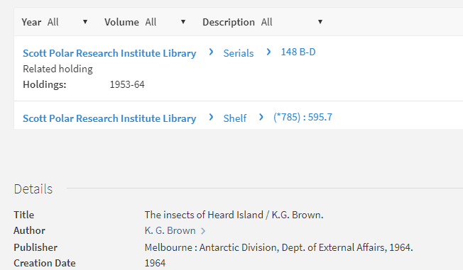
Analytics – parent/child relationships
Extensive 773/852 logic
Pamphlet handling
Processing order
Language selection
Name alignment with UL

Slide 25
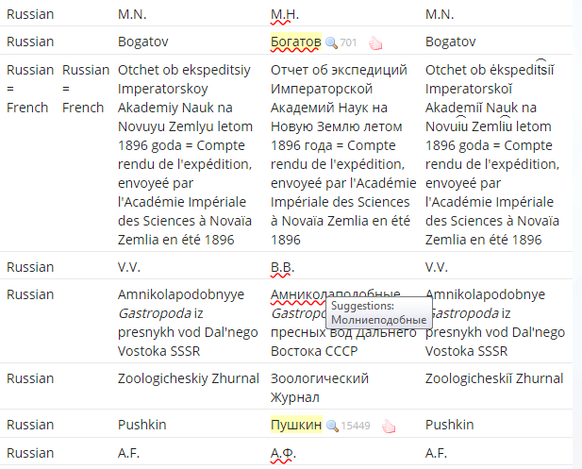
Russian / Transliteration
Highly complex area
140,000 new Cyrillic strings
Muscat: Roman charset
BGN/PCGN 1947
Non-reversible scheme!
30+ stages to get to 880s
Language identification
Italics: names, etc.
Parallel titles, etc.
https://github.com/camunigeog/muscat-conversion/blob/master/doc/transliteration.md

Slide 26
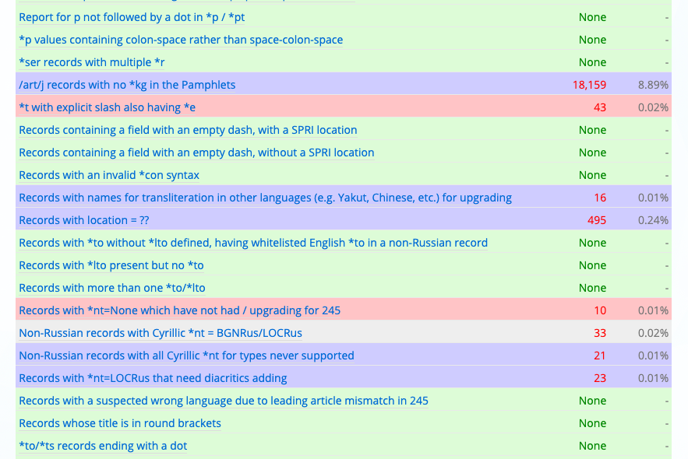
Reports
Reports define conditions which a record must or must not match. Enables problems with the records to be tackled over time.
Plenty of work to fix these for years to come!

Slide 27
Project close
Data was finalised end September 2019, and set to University Library.
Plans for journal article about the conversion project.
Code is open source on Github (and will have a DOI soon): https://github.com/camunigeog/muscat-conversion
Documentation at: https://github.com/camunigeog/muscat-conversion/tree/master/doc
Ongoing long-term work to fix up legacy record data

Slide 28
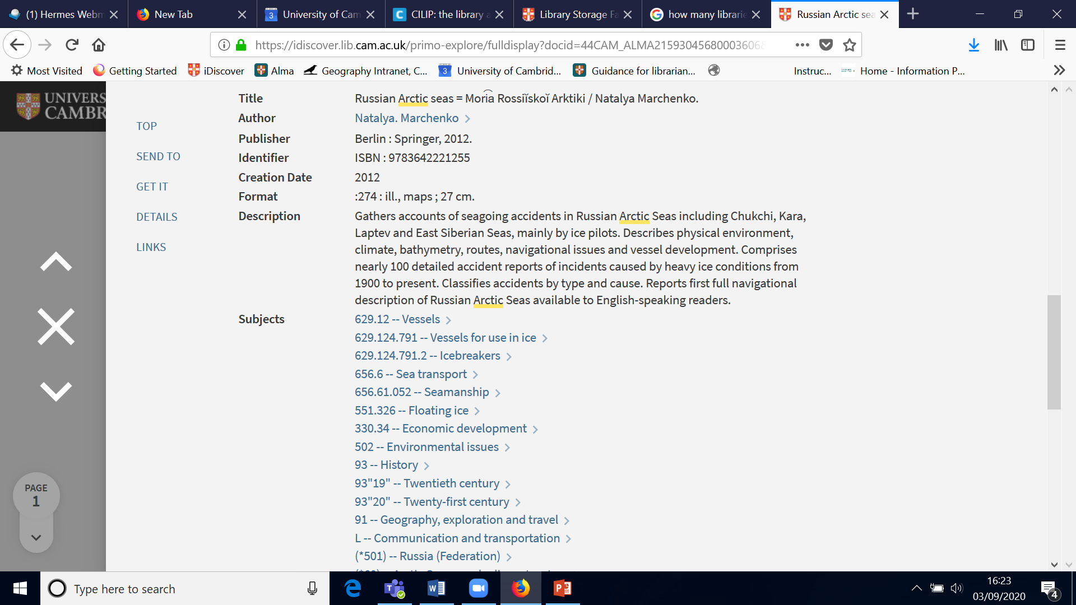
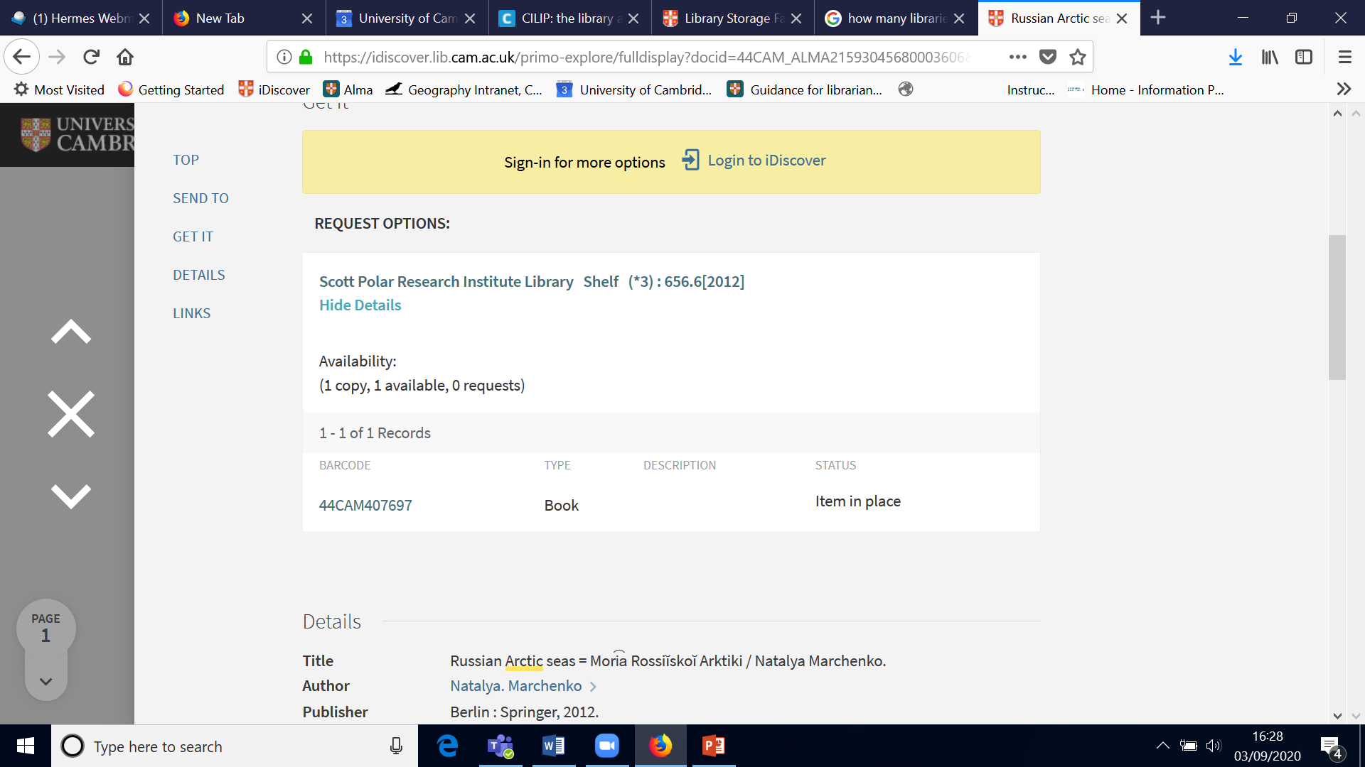
Sample record: iDiscover

Slide 29
Sample Alma Record
Leader 02765nam a2200517 a 4500
001 991006442493603606
005 20190930020543.0
007 ta
008 190930s2012 gw ab | |0|| 0 eng d
020 ##$a9783642221255
035 ##$aSPRI-204602
040 ##$aUkCU-P$beng$eaacr
041 0#$aeng$arus
100 1#$aMarchenko, Natalya.
245 10$6880-01$aRussian Arctic seas = Mori︠a︡ Rossiĭskoĭ Arktiki /$cNatalya Marchenko.
260 ##$aBerlin :$bSpringer,$c2012.
300 ##$a:274 :$bill., maps ;$c27 cm.
520 3#$aGathers accounts of seagoing accidents in Russian Arctic Seas including Chukchi, Kara, Laptev and East Siberian Seas, mainly by ice pilots. Describes physical environment, climate, bathymetry, routes, navigational issues and vessel development. Comprises nearly 100 detailed accident reports of incidents caused by heavy ice conditions from 1900 to present. Classifies accidents by type and cause. Reports first full navigational description of Russian Arctic Seas available to English-speaking readers.
541 0#$cBA Russia;$aBooks2anywhere US, Amazon$d20130906$eR0031$h54.70 GBP.$5UkCU-P
546 ##$aIn English and Russian.
546 ##$aRussian transliteration entered into original records using BGN/PCGN 1947 romanisation of Russian; Cyrillic text in MARC 880 field(s) reverse transliterated from this by automated process; BGN/PCGN 1947 text then upgraded to Library of Congress romanisation.

Slide 30
Sample Alma Record (continued)
650 07$a629.12 -- Vessels.$2udc
650 07$a629.124.791 -- Vessels for use in ice.$2udc
650 07$a629.124.791.2 -- Icebreakers.$2udc
650 07$a656 continued.6 -- Sea transport.$2udc
650 07$a656.61.052 -- Seamanship.$2udc
650 07$a551.326 -- Floating ice.$2udc
650 07$a330.34 -- Economic development.$2udc
650 07$a502 -- Environmental issues.$2udc
650 07$a93 -- History.$2udc
650 07$a93"19" -- Twentieth century.$2udc
650 07$a93"20" -- Twenty-first century.$2udc
650 07$a91 -- Geography, exploration and travel.$2udc
650 07$aL -- Communication and transportation.$2local
651 #7$a(*501) -- Russia (Federation).$2udc
651 #7$a(*60) -- Arctic Ocean and adjacent waters.$2udc
651 #7$a(*68) -- Arctic Ocean, seas adjacent to Russia.$2udc
651 #7$a(*682) -- Chukchi Sea.$2udc
651 #7$a(*683) -- East Siberian Sea.$2udc
651 #7$a(*684) -- Laptev Sea.$2udc
651 #7$a(*685) -- Kara Sea.$2udc
880 10$6245-01/(N$aRussian Arctic seas = Моря Российской Арктики /$cНаталыа Марченко.
916 ##$a148457 -- 2014/06/30 -- NOM
917 ##$aUnenhanced record from Muscat, imported 2019
948 3#$a20190930 $bIW; NOM

